Slide 1
STAT 345 Final Project
By Matt Nowell, Sam Schuster, James Spalding, and Ben Bronoski

Slide 2
Research Question
Have songs become more repetitive over time?
How did we test this?
Test if individual words are repeated more often on average
Test if the song title shows up in the lyrics more often

Slide 3
Our Approach
Data Collection
Song Collection
Lyric Collection
Data Analysis
Graphs
Word Clouds

Slide 4


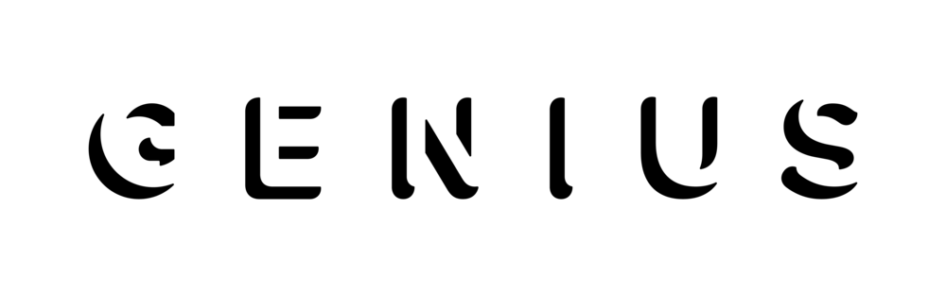
Data Collection

Slide 5
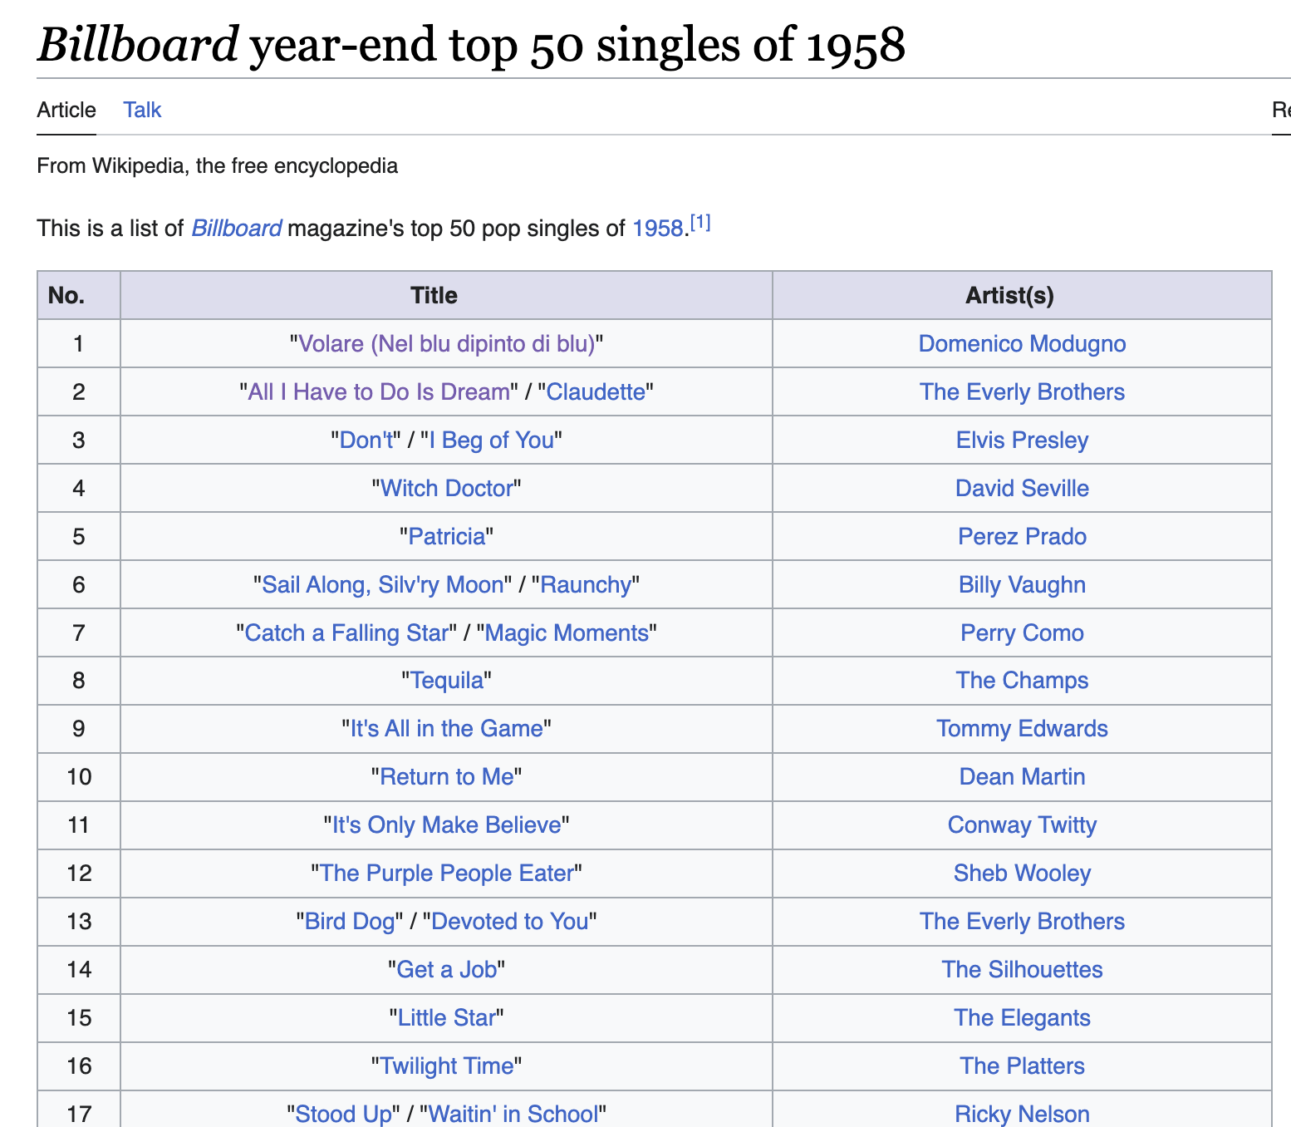
Song Collection
The first step of this project was to find the list of top songs themselves.
We ended up finding a wikipedia page which did just that!

Slide 6
The main reason we chose to use this page was because the URL was formatted the same for every single year that we needed.
Note that the only difference is the year

Slide 7
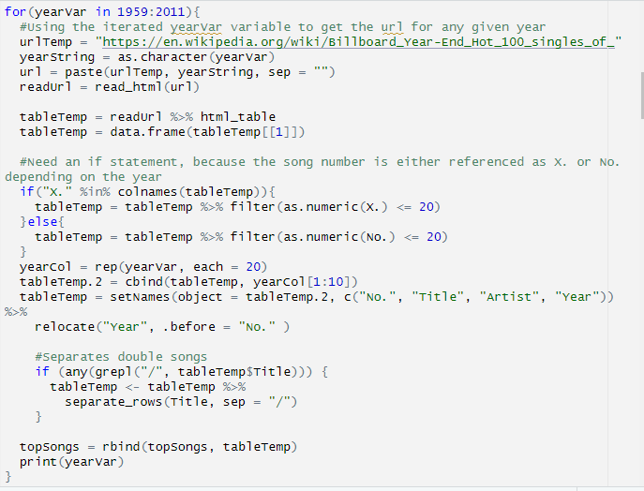
Link Generation Pt. 1
Using the variable yearVar, we were able to put any range of years we chose into a for loop.
The loop will create wikipedia links for each year and output the contents into a table with over 1300 songs!

Slide 8
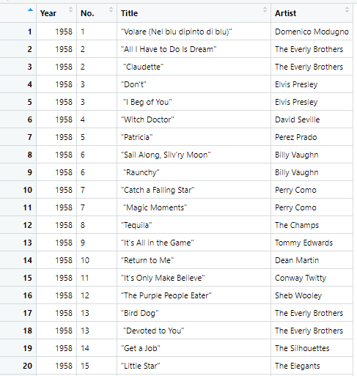
Table of Top 20 Songs

Slide 9

Lyric Collection
With our song collection complete, we could now move on to lyric collection.
We used genius.com to help us achieve this goal.

Slide 10
We chose Genius for the same reason we chose the wikipedia page: because the links were formatted cleanly.
Follows the format: genius.com/Artist-name-song-name-lyrics

Slide 11
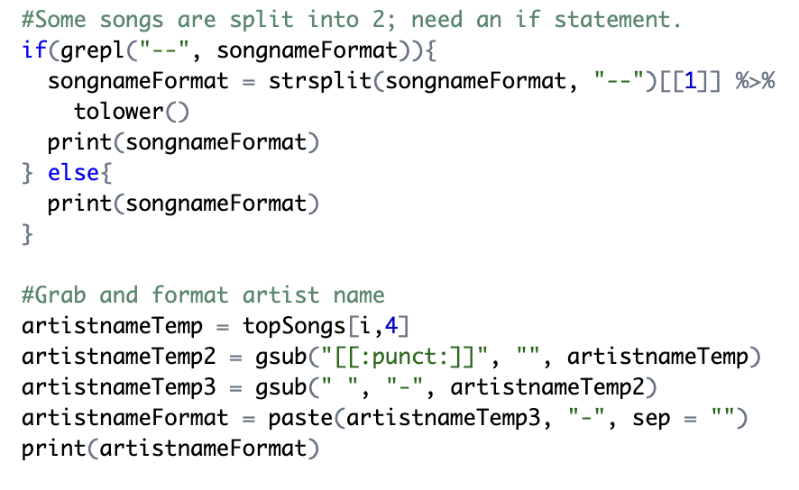
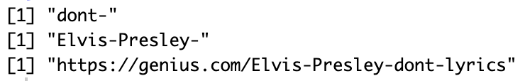
Link Generation Pt. 2
Input
As we already have artist name and song title in our table, generating a link for genius was as simple as pulling the strings from the table, formatting them, and pasting them into a working link.
Format
Output

Slide 12
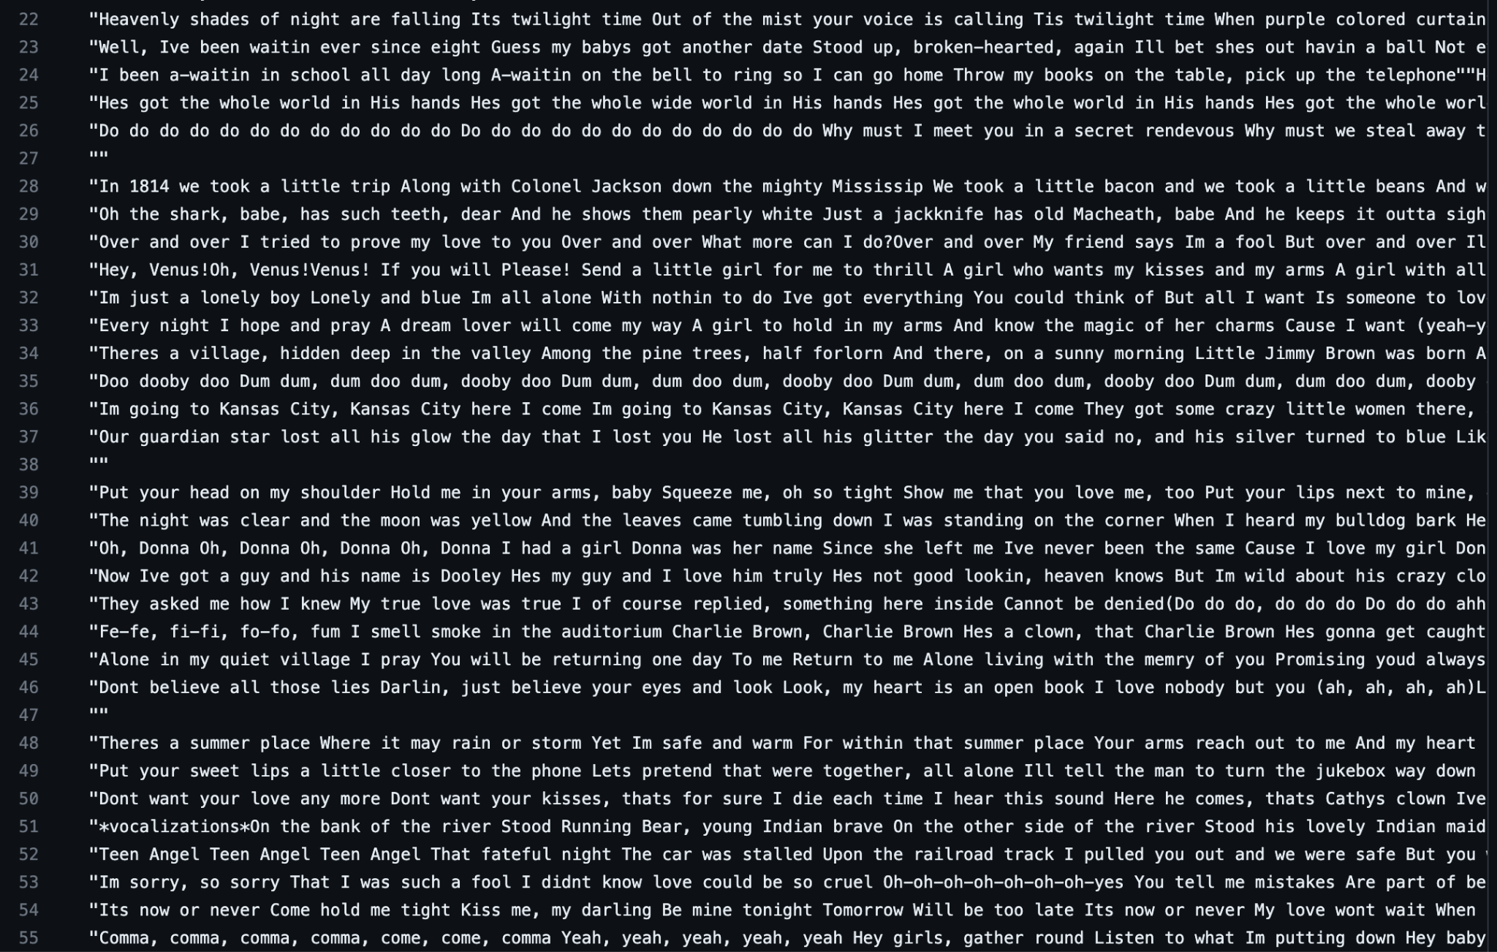
Processing
Running the lyric-generating function took a long time (Well over an hour). Because of this, we ended up only running it once and putting its output into a .CSV file.

Slide 13
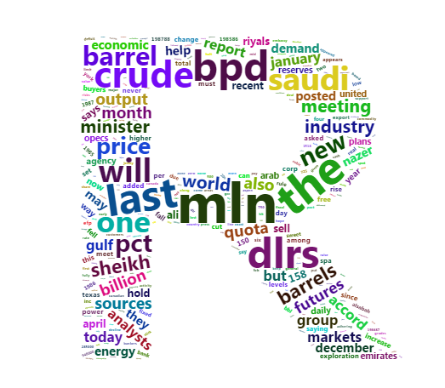
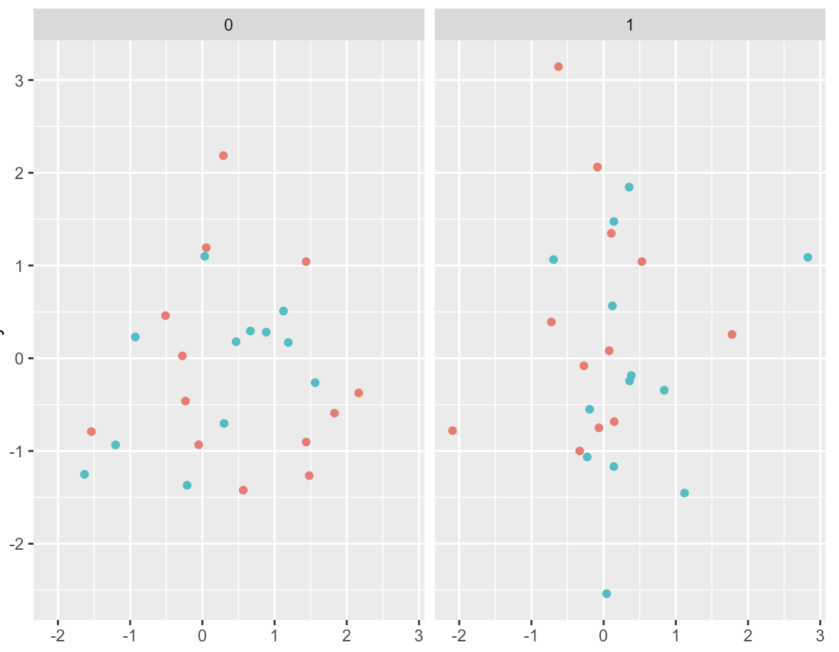
Data Analysis

Slide 14
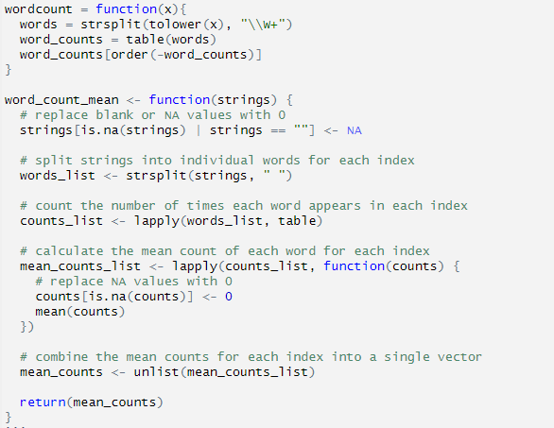
Word Counting
Process to determine how often any given word would be repeated in each song
Counts are generated for each word in each song, then the average is taken of those counts for each song

Slide 15
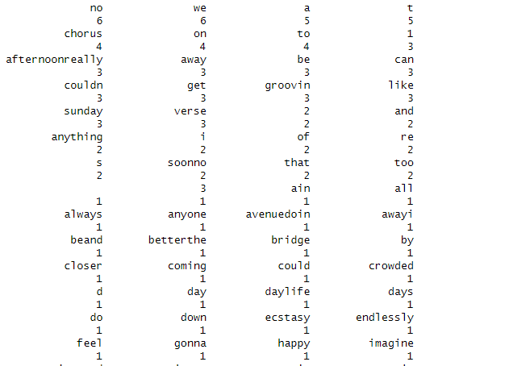
Word Count sample
Sample counts show some of the problems we ran into in the data cleaning process
Words that ended a line and began the next line would get connected without a space
Words with an apostrophe would turn into 2 “words”

Slide 16
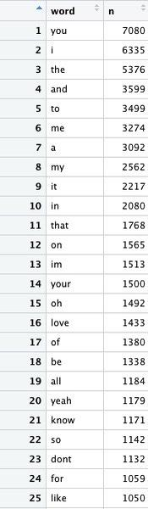
Total Word Count Table
This table contains the count of every word from the top 20 songs since 1958.

Slide 17

With all of our data collection complete, we can finally answer our question of whether or not songs have gotten more repetitive over time!
The answer, according to our research, is…

Slide 18
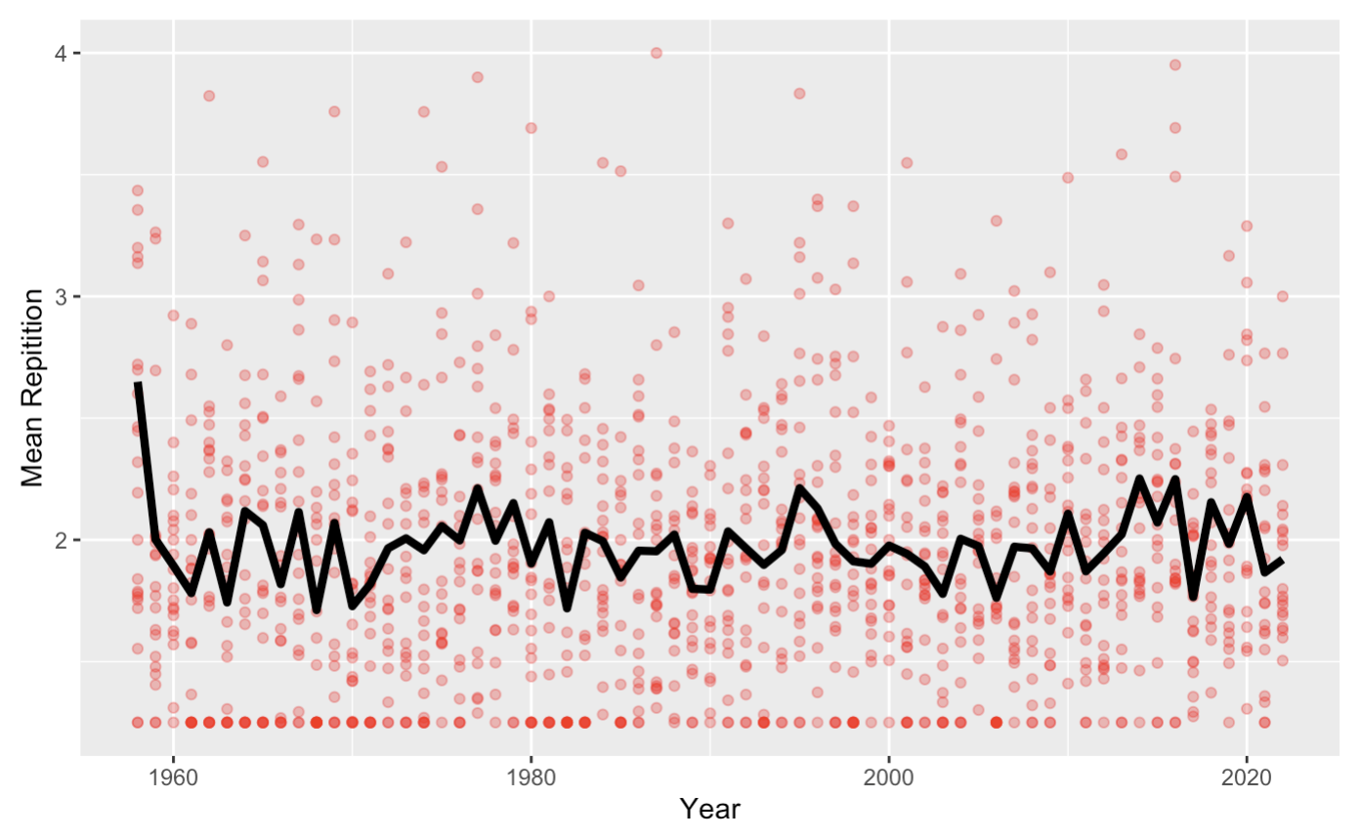
A resounding no.
From what we can tell, there is no correlation whatsoever between year and mean word repetition in songs.
Note the large spike in 1958.

Slide 19
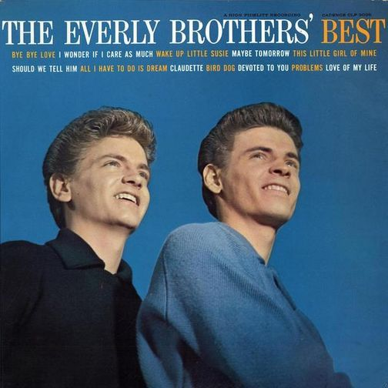
The major outlier
“All I Have To Do Is Dream” by The Everly Brothers repeats the word “dream” an incredible 28 times throughout the song. This is by far the most repetition of any song in our list, skewing the year of 1958 higher than it should be.

Slide 20
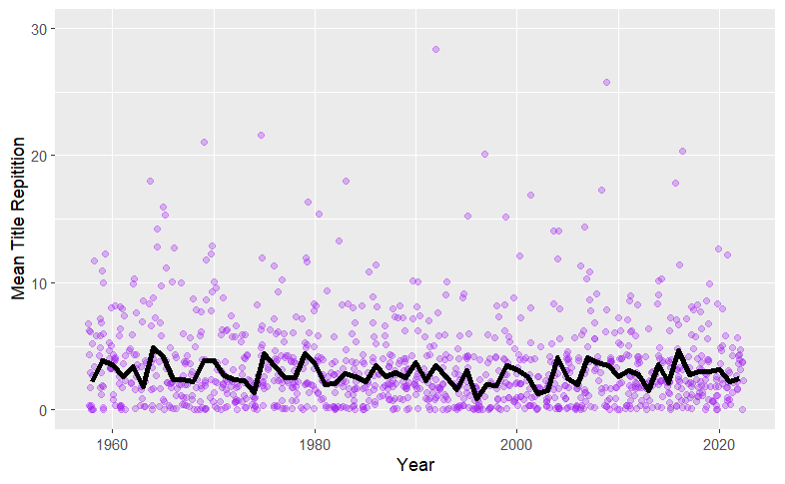
We also decided to search for the song title in the lyrics.
The results show no trend in song title presence in the lyrics
A similar counting method was utilized to search for the title within the songs. However rather than counting individual words the str_count() function was used to match the title to the lyrics. Occurrences were then averaged by year and mapped accordingly.

Slide 21
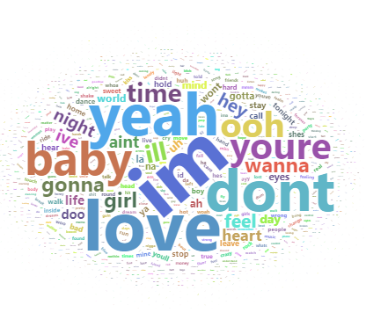
Word Clouds
Idea was to create a visual of all of the words from all of the songs to see what words show up most often
Most common word across 60+ years of lyrics is “I’m”

Slide 22
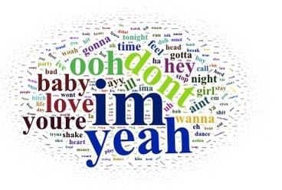
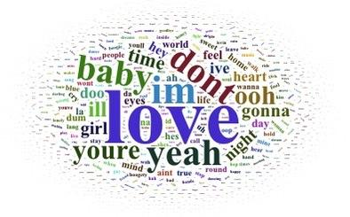
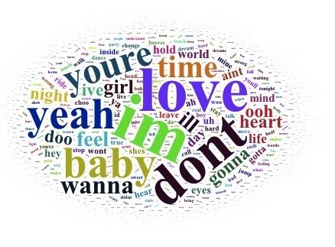
Word Clouds by Different Years
1979 to 1999
2000-present
1958-1978

Slide 23
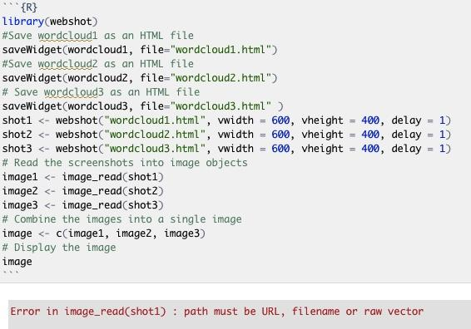
Attempting to Display Word Clouds in one Output
We then wanted to display all of the Word Clouds together as one output, but this was difficult since the output of the wordcloud() function was a html widget. We tried using the webshot package to combine them but ultimately was unable to do so.

Slide 24
Conclusion
Songs are no more repetitive now than they have been in the past
Whether searching through individual words or searching for song titles in lyrics, there is no apparent trend
Extreme outliers are the only ones that show any repetitiveness (All I have to do is Dream)

